Slide 1

Bayes’ Theorem and the Prosecutor’s fallacy
Michael Ippolito
Data Science in Context
Data607

Slide 2
BAYES’ THEOREM and the Prosecutor’s fallacy
Prosecutor’s Fallacy
Is it some obscure, rare statistical phenomenon?
Is it easily or commonly understood?
How can we correct it?
Law
Medicine
Society

Slide 3
BAYES’ THEOREM and the Prosecutor’s fallacy
Law
McDaniel v. Brown
Medicine
COVID-19 rapid antigen testing
Society
Cheating at the lottery

Slide 4
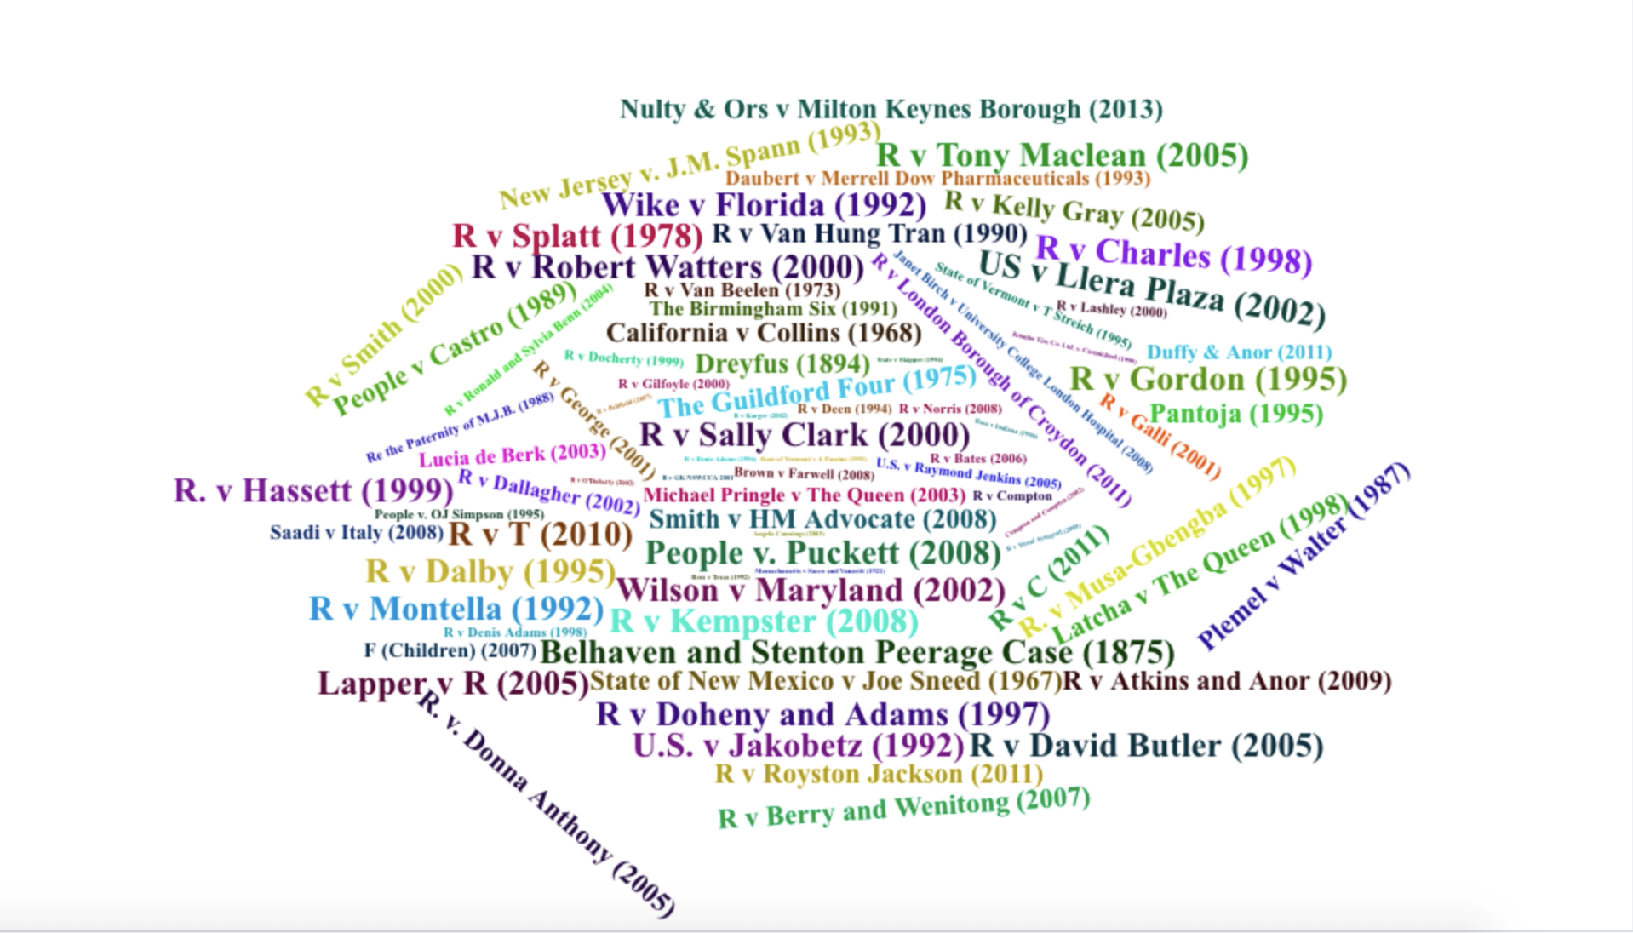
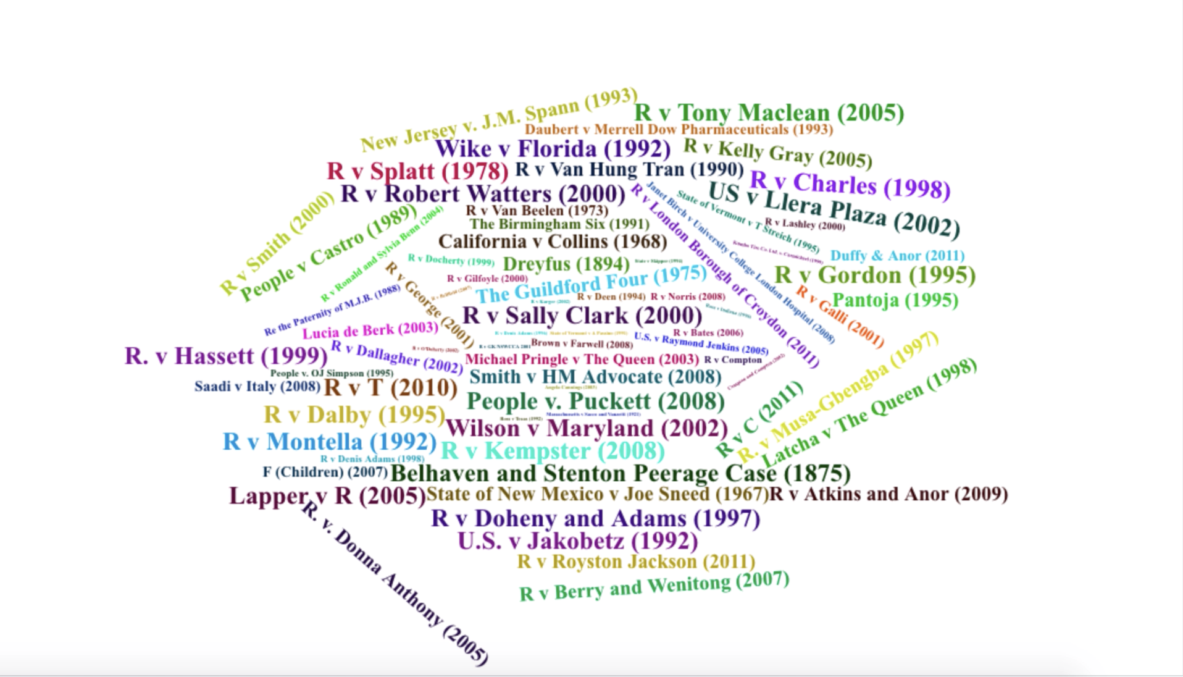
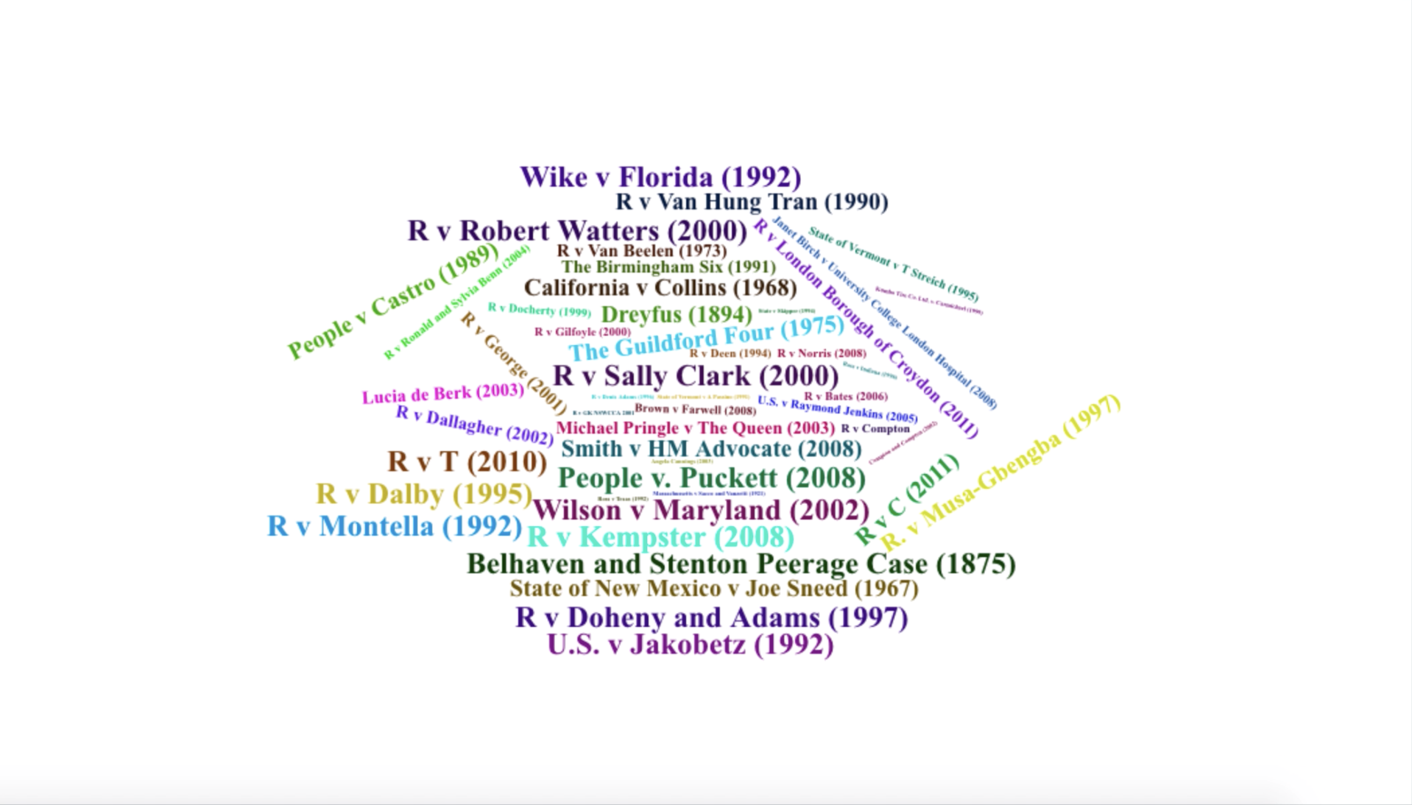
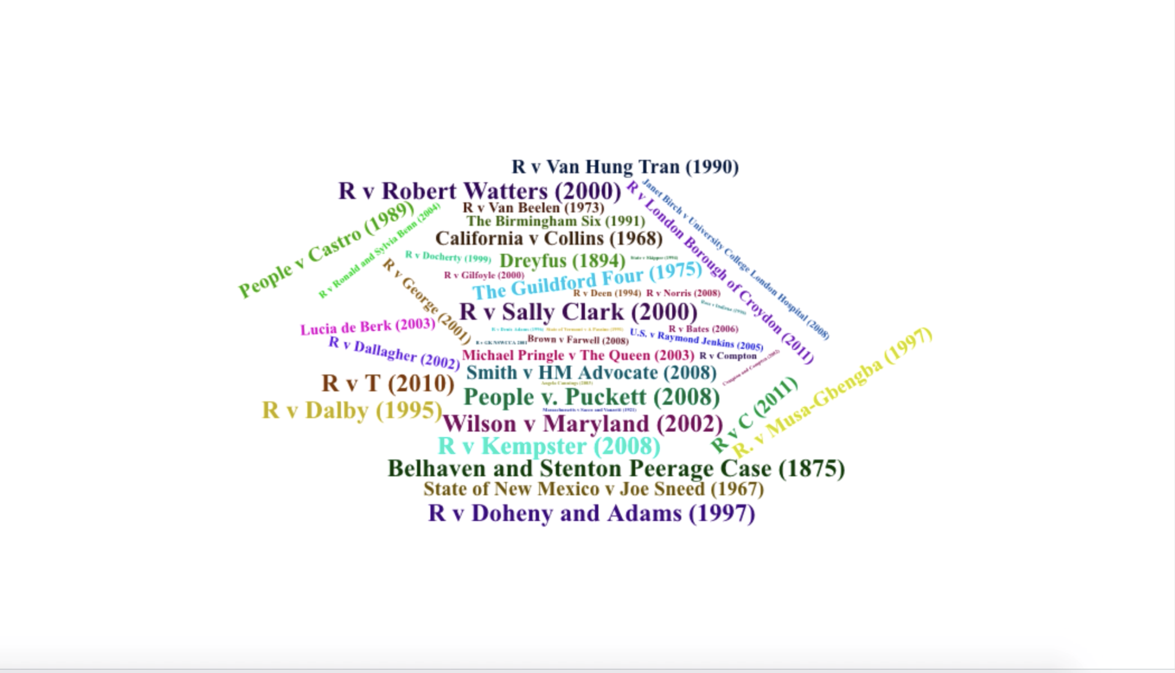
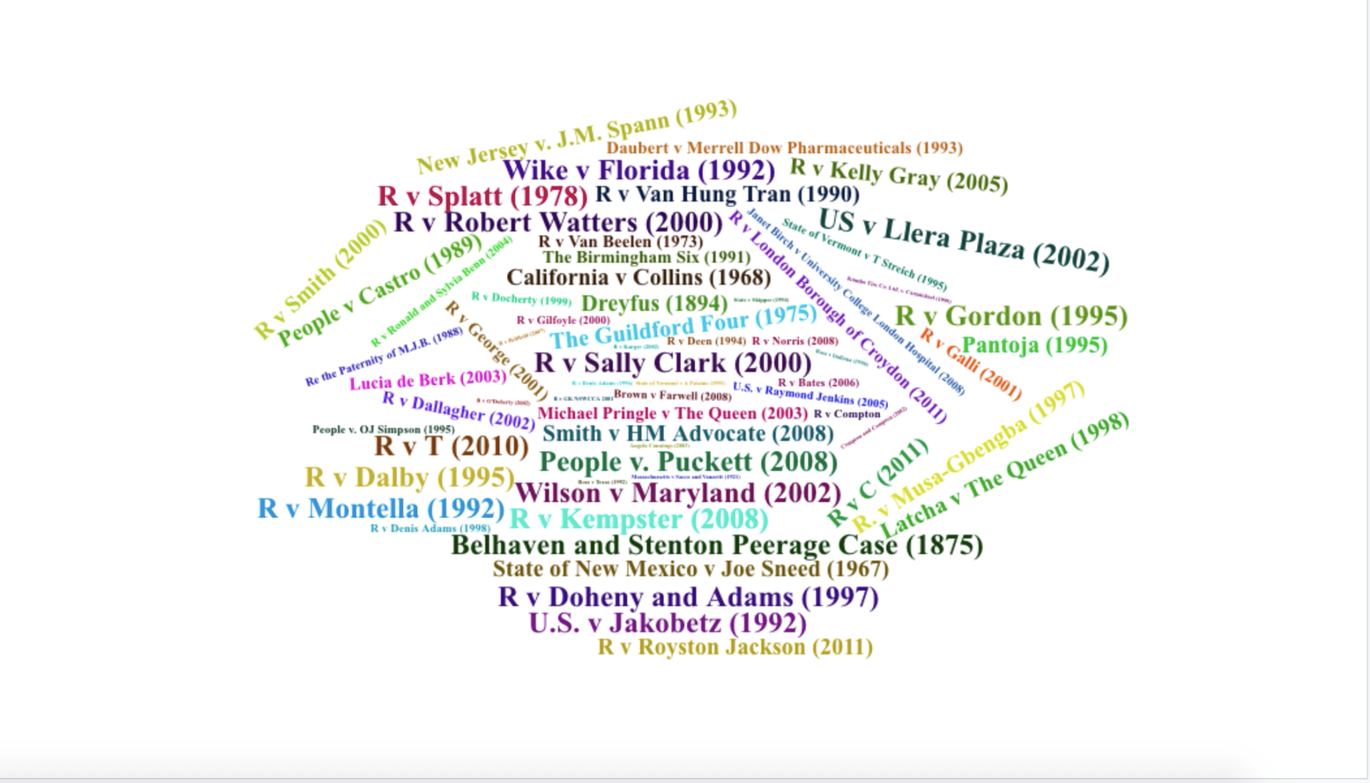
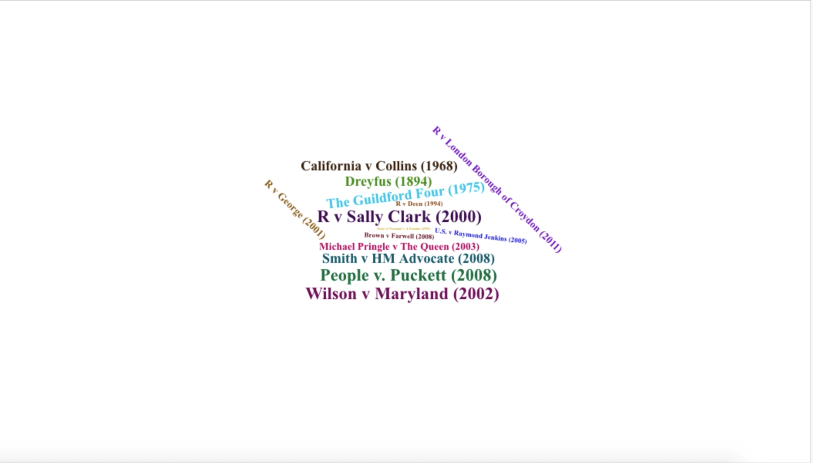
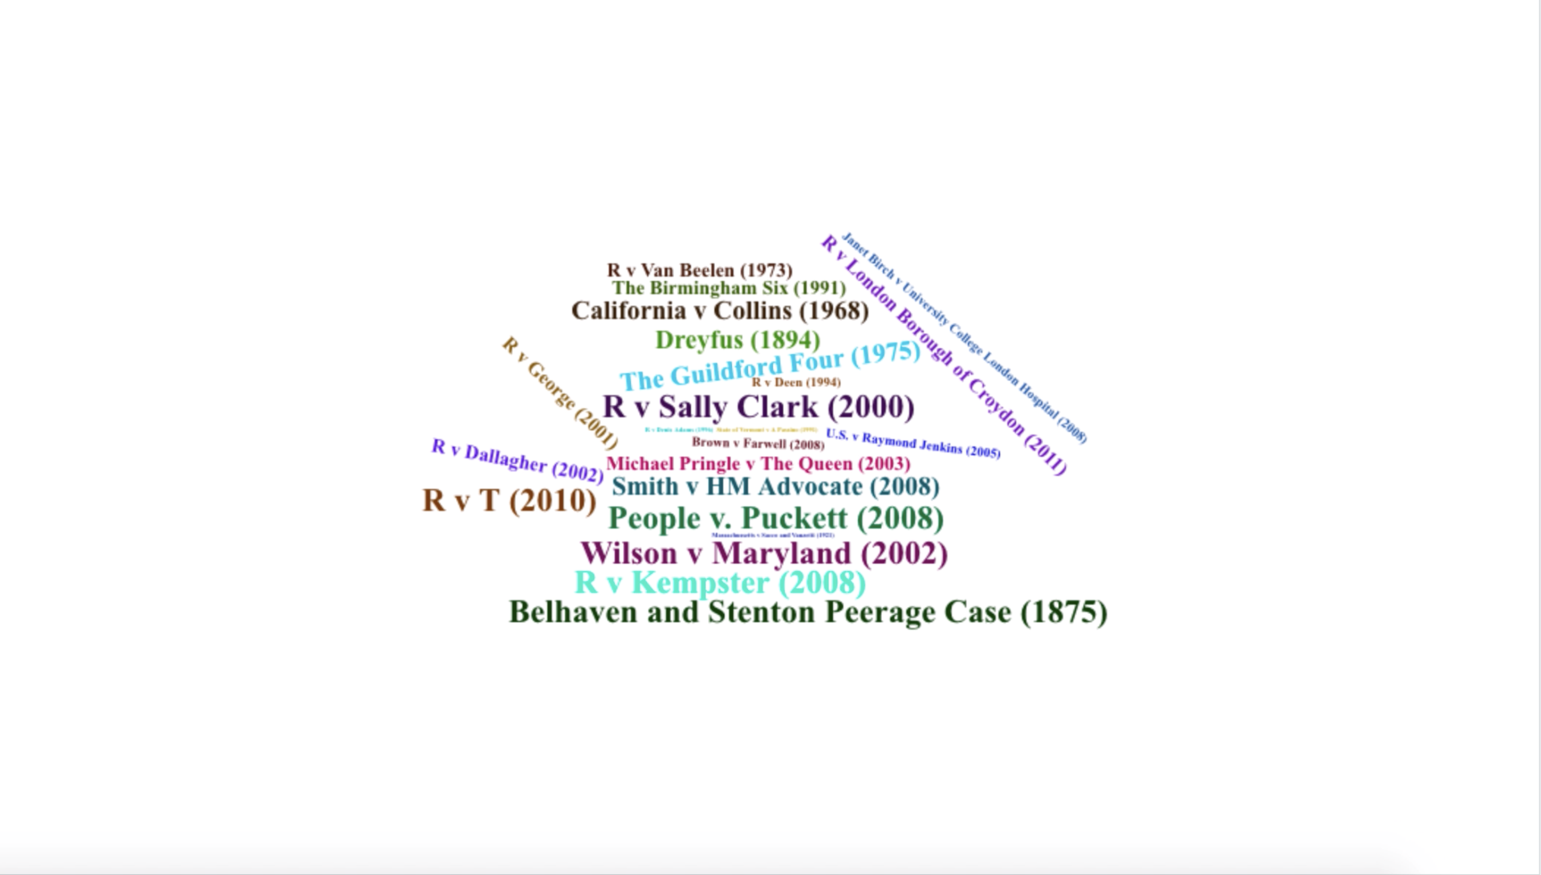
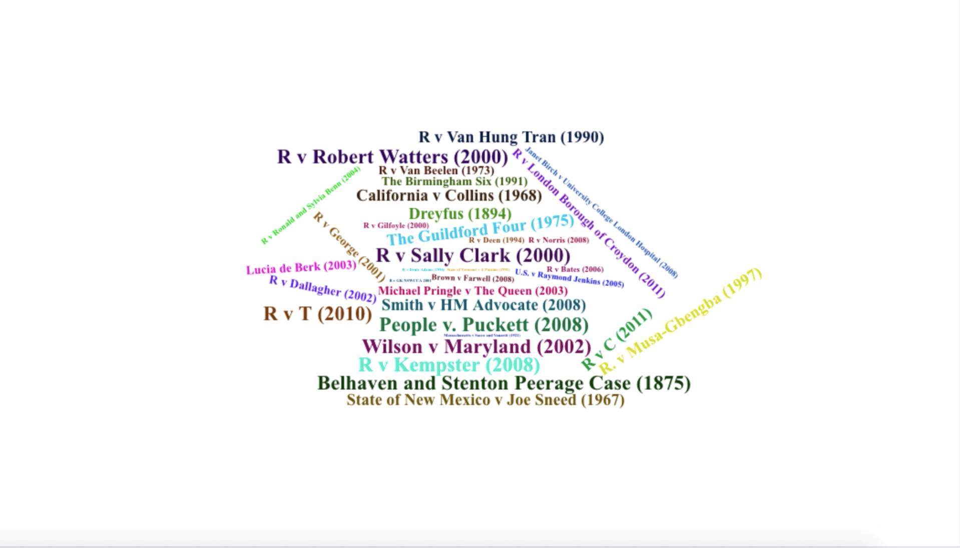
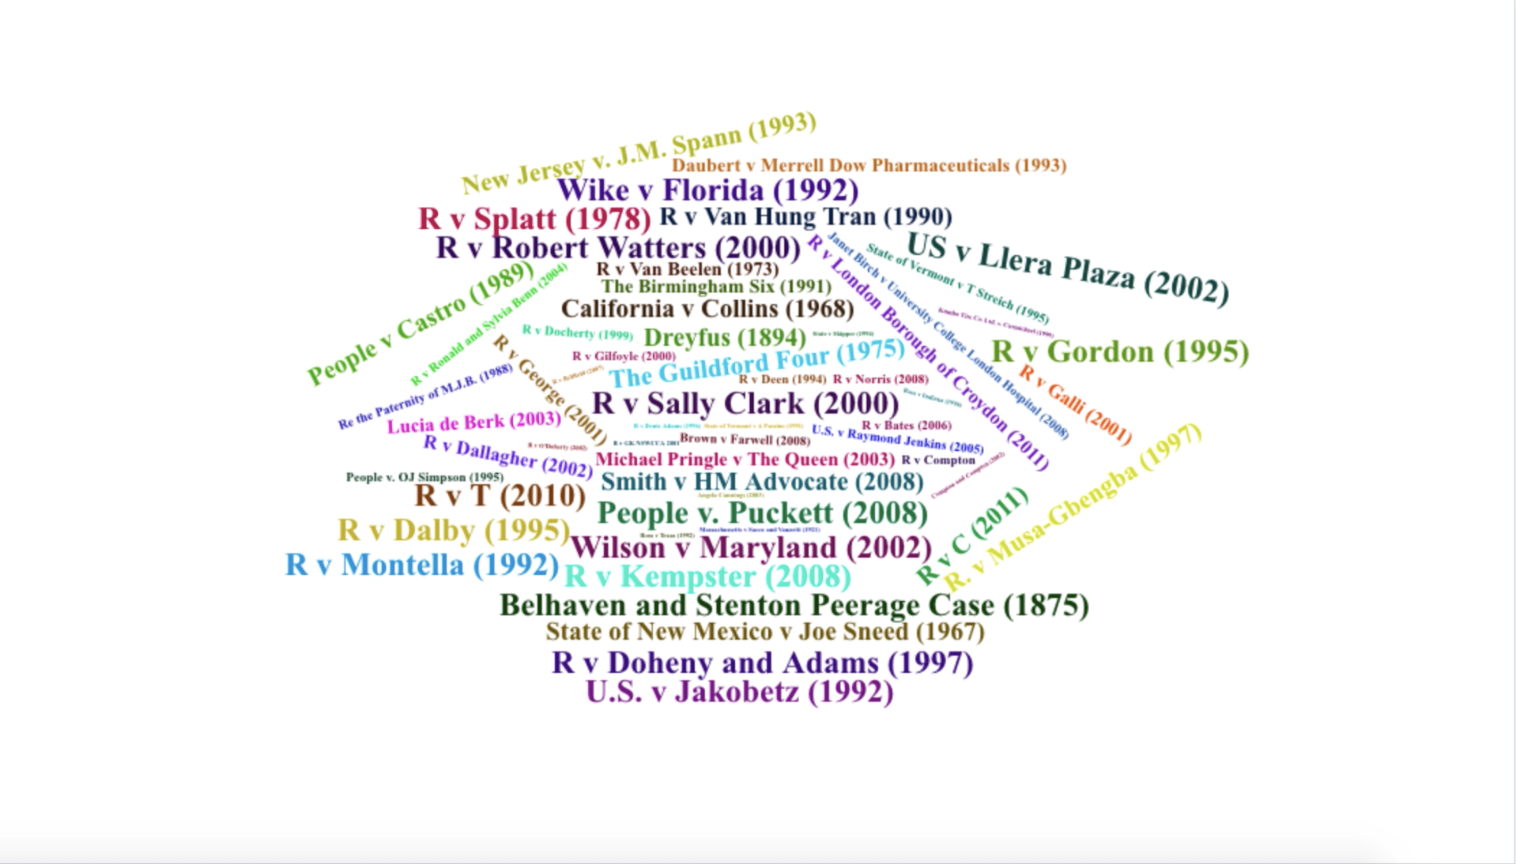
BAYES’ THEOREM and the Prosecutor’s fallacy
Law
Medicine
Society
MacDaniel v Brown (2010)
Cases from https://sites.google.com/site/bayeslegal/legal-cases-relevant-to-bayes

Slide 5
BAYES’ THEOREM and the Prosecutor’s fallacy
Law
Medicine
Society
MacDaniel v Brown (2010)
Cases from https://sites.google.com/site/bayeslegal/legal-cases-relevant-to-bayes

Slide 6
BAYES’ THEOREM and the Prosecutor’s fallacy
MacDaniel v Brown (2010)*
Defendant: Troy Brown (Nevada, 1997)
Charge: Sexual assault
Verdict: Guilty
Sentence: Life (with possibility of parole after 10 years)
Appeal: Applied the Jackson Standard (Jackson v. Virginia, 1979: no way a rational person could have found defendant guilty beyond a reasonable doubt, cited prosecutor’s fallacy)
Supreme Court Ruling:
???
Law
Medicine
Society
*https://www.supremecourt.gov/opinions/09pdf/08-559.pdf

Slide 7


BAYES’ THEOREM and the Prosecutor’s fallacy
Expert testimony:
DNA at crime scene matched Troy’s
1 in 3,000,000 chance that the DNA came
from someone other than Troy
Prosecutor:
Likelihood that Troy is innocent = 1 in 3,000,000
Prosecutor’s fallacy
Likelihood that Troy is guilty = 2,999,999 in 3,000,000
Law
Medicine
Society

Slide 8
BAYES’ THEOREM and the Prosecutor’s fallacy
 | DNA matches | DNA does not match | Total
Guilty | 1 | 0 | 1
Innocent | 1 | 2,999,998 | 2,999,999
Total | 2 | 2,999,998 | 3,000,000
People who share Troy’s DNA:
P(innocent):
P(innocent | DNA matches):
1 in 3,000,000
1 in 3,000,000
1 in 2 (50%)
Law
Medicine
Society

Slide 9
BAYES’ THEOREM and the Prosecutor’s fallacy
Bayes’ Theorem*
p(AB) = p(A) * p(B | A) [joint probability]
p(innocent ^ DNA match) = p(innocent) * p(DNA match | innocent)
p(DNA match ^ innocent) = p(DNA match) * p(innocent | DNA match)
p(innocent ^ DNA match) = p(DNA match ^ innocent)
p(DNA match) * p(innocent | DNA match) =
p(innocent) * p(DNA match | innocent)
p(innocent | DNA match) = p(innocent) * p(DNA match | innocent)
p(DNA match)
Law
Medicine
Society
*Provost & Fawcett, Data Science for Business, 2013.

Slide 10
BAYES’ THEOREM and the Prosecutor’s fallacy
 | DNA matches | DNA does not match | Total
Guilty | 1 | 0 | 1
Innocent | 1 | 2,999,998 | 2,999,999
Total | 2 | 2,999,998 | 3,000,000
p(innocent | DNA match) = p(innocent) * p(DNA match | innocent)
p(DNA match)
= 2,999,999 / 3,000,000 * 1 / 2,999,999
2 / 3,000,000
Law
Medicine
Society
= 1 / 2 (50%)

Slide 11
BAYES’ THEOREM and the Prosecutor’s fallacy
 | DNA matches | DNA does not match | Total
Guilty | 1 | 0 | 1
Innocent | 109 | 327,999,890 | 327,999,999
Total | 110 | 327,999,890 | 328,000,000
Defender’s fallacy
P(innocent):
109 in 110 (99.1%)
Law
Medicine
Society

Slide 12
BAYES’ THEOREM and the Prosecutor’s fallacy
MacDaniel v Brown (2010)*
Supreme Court Ruling:
Guilty verdict stands
Fed appeals court “misapplied” Jackson Standard
Despite prosecutor’s fallacy, odds of guilt still high
Other evidence
Law
Medicine
Society
*https://www.supremecourt.gov/opinions/09pdf/08-559.pdf

Slide 13
BAYES’ THEOREM and the Prosecutor’s fallacy
Quidel COVID-19 rapid antigen test*
 | Test pos | Test neg | Total
Has COVID | True pos | False pos | Total w/COVID
Does not have COVID | False neg | True neg | Total w/o COVID
Total | Total pos | Total neg | N
Sensitivity: 96.7%
Specificity: 99%
Accuracy: 98.95%
true pos / total w/COVID
true neg / total w/o COVID
true pos + true neg / N
Law
Medicine
Society
*https://www.medtechdive.com/news/quidel-says-its-covid-19-antigen-test-is-now-on-par-with-pcr-accuracy/581902/

Slide 14
BAYES’ THEOREM and the Prosecutor’s fallacy
If your rapid antigen test is positive, what is the probability that you have COVID-19?
Choose me!
Choose me!
Choose me!
Choose me!
Choose me!
Choose me!
Prosecutor’s fallacy
Choose me!
Sensitivity: 96.7%
Choose me!
Choose me!
Choose me!
Choose me!
Choose me!
Choose me!
Choose me!
Choose me!
Choose me!
Choose me!
Choose me!
P(COVID | pos test): ???
Law
Medicine
Society

Slide 15
BAYES’ THEOREM and the Prosecutor’s fallacy
COVID-19 cases in U.S. (Feb 2021): 2.1% *
 | Test pos | Test neg | Total
Has COVID | 20,307 | 693 | 21,000
Does not have COVID | 9,790 | 969,210 | 979,000
Total | 30,097 | 969,903 | 1,000,000
Sensitivity:
P(COVID):
P(COVID | test pos):
96.7%
96.7%
67.5% (20,307 / 30,097)
Law
Medicine
Society
*https://www.news-medical.net/news/20210208/New-machine-learning-algorithm-estimates-number-of-COVID-19-cases-in-the-US.aspx#:~:text=Of%20those%2071%20million%20Americans,were%20potentially%20contagious%20on%20Feb.

Slide 16
BAYES’ THEOREM and the Prosecutor’s fallacy
Cases of smallpox: 0% (eradicated in 1977)
 | Test pos | Test neg | Total
Has smallpox | 0 | 0 | 0
Does not have smallpox | 10,000 | 990,000 | 1,000,000
Total | 10,000 | 990,000 | 1,000,000
Sensitivity:
P(smallpox):
P(smallpox | test pos):
96.7%
96.7%
0% (0 / 10,000)
Law
Medicine
Society

Slide 17
BAYES’ THEOREM and the Prosecutor’s fallacy
 | Test pos | Test neg | Total
Has COVID | 20,307 | 693 | 21,000
Does not have COVID | 9,790 | 969,210 | 979,000
Total | 30,097 | 969,903 | 1,000,000
p(COVID | test pos) = p(COVID) * p(test pos | COVID)
p(test pos)
= 21,000 / 1,000,000 * 20,307 / 21,000
30,097 / 1,000,000
= 20,307 / 30,097 = 67.5%
Law
Medicine
Society

Slide 18
BAYES’ THEOREM and the Prosecutor’s fallacy
Powerball Lottery
Odds of winning:
1 in 292,000,000*
Probability you cheated:
Prosecutor’s fallacy
291,999,999 in 292,000,000*
Law
Medicine
Society
*https://www.medtechdive.com/news/quidel-says-its-covid-19-antigen-test-is-now-on-par-with-pcr-accuracy/581902/

Slide 19
BAYES’ THEOREM and the Prosecutor’s fallacy
Avg people who play:
Number of people who try to cheat:
12,000,000*
3
 | Winning ticket | Losing ticket | Total
Cheated | 3 | 0 | 3
Did not cheat | 1 | 11,999,996 | 11,999,997
Total | 4 | 11,999,996 | 12,000,000
Odds:
P(cheated):
P(cheated | winning ticket):
1 in 292,000,000
291,999,999 in 292,000,000
75% (3 / 4)
Law
Medicine
Society
*https://lottoreport.com/ticketcomparison.htm

Slide 20
BAYES’ THEOREM and the Prosecutor’s fallacy
 | Winning ticket | Losing ticket | Total
Cheated | 3 | 0 | 3
Did not cheat | 1 | 11,999,996 | 11,999,997
Total | 4 | 11,999,996 | 12,000,000
p(cheated | winning ticket) = p(cheated) * p(winning ticket | cheated)
p(winning ticket)
= 3 / 12,000,000 * 3 / 3
4 / 12,000,000
= 3 / 4 = 75%
Law
Medicine
Society

Slide 21
BAYES’ THEOREM and the Prosecutor’s fallacy
Conclusion
More statistical training for legal professionals, doctors
Know what you’re being given when you see a rate, probability, or odds
Prosecutor’s fallacy
You might have smallpox!
Law
Medicine
Society

Slide 22
BAYES’ THEOREM and the Prosecutor’s fallacy
Prosecutor’s fallacy
Questions?
Law
Medicine
Society

